Slide 1
Capstone Project - PG Certification in AI-ML and Data Science by IIT Roorkee
Power Forecast Optimization for Energy Operations
By – Rabindra Singh Negi

Slide 2
Project Overview
What is this project about? This project leverages real-world sensor data from a Combined Cycle Power Plant (CCPP) to predict net energy output (PE) using various environmental factors. The goal is to help optimize energy generation, enhance efficiency, and support sustainable resource management.
Why is it important? Energy production efficiency is crucial for reducing fuel consumption and lowering environmental impact. Predicting the power output allows plant operators to make better decisions, avoid under/overproduction, and reduce operational costs.
So what? By developing a robust machine learning model (XGBoost), we demonstrate how data science can directly support energy optimization, sustainability goals, and cost-effective production planning.
Business Context : Power generation companies operate in a highly cost-sensitive and efficiency-driven environment. The Combined Cycle Power Plant (CCPP) is designed to generate power using both gas and steam turbines, making it more efficient than conventional methods. However, fluctuating environmental conditions such as temperature, ambient pressure, humidity, and exhaust vacuum can significantly impact energy production.

Slide 3
Project Goal
To analyze the environmental and accurately predict the Net Energy Output (PE) of the power plant based on key environmental parameters such as:
Ambient Temperature (AT)
Exhaust Vacuum (V)
Ambient Pressure (AP)
Relative Humidity (RH) The final model is expected to support energy production forecasting with relevant analysis, high accuracy and minimal error.
Data Overview
Source : UCI
Name: Combined Cycle Power plant research test data
Features: Column | Description | ---------|-------------------------------------| AT | Ambient Temperature (°C) | V | Exhaust Vacuum (cm Hg) | AP | Ambient Pressure (millibar) | RH | Relative Humidity (%) | PE | Net Energy Output (target) in MW |

Slide 4
Methodology
Evaluation
Model Training
Feature Extraction
Data Preprocessing
Data Acquisition & Visualization

Slide 5
Data Acquisition
For Data we will be using already available dataset provided by UCI Machine Learning.
The dataset contains 9568 data points collected from a Combined Cycle Power Plant over 6 years (2006-2011), when the plant was set to work with full load..
There are total 1,03,904 rows and 25 columns in the training dataset and 25,976 rows and 25 columns in testing dataset including both numerical and categorical information.
Code - https://github.com/rnegi0/Power-Forecast-Optimization-for-Energy-Operations

Slide 6
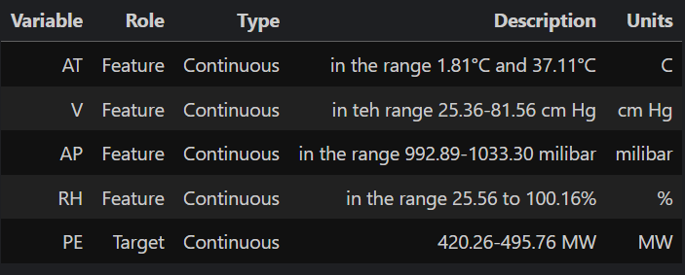
Data Description
Data Exploration and Understanding In the exploratory data analysis, I will analyze the relationship between the target variable and the independent variables. I will also analyze the relationship between the independent variables. This will help me to understand the data better and to find out the variables that have most impact on the target variable.

Slide 7
Data Preprocessing
Feature Engineering Given the high correlation(From heatmap) between AT and V, along with their strong correlation with PE, creating a derived feature such as AT × V could be beneficial. This would capture their combined interaction effect on the target variable (PE) and may improve model performance.
Why Consider AT × V? Since both features strongly influence PE and are highly correlated, their interaction may explain additional variance in PE that the model cannot capture using the individual features alone. Feature engineering can sometimes help mitigate multicollinearity by transforming the features into forms where the redundancy is reduced..
Code - https://github.com/gitmnikhil/capstoneproject

Slide 8
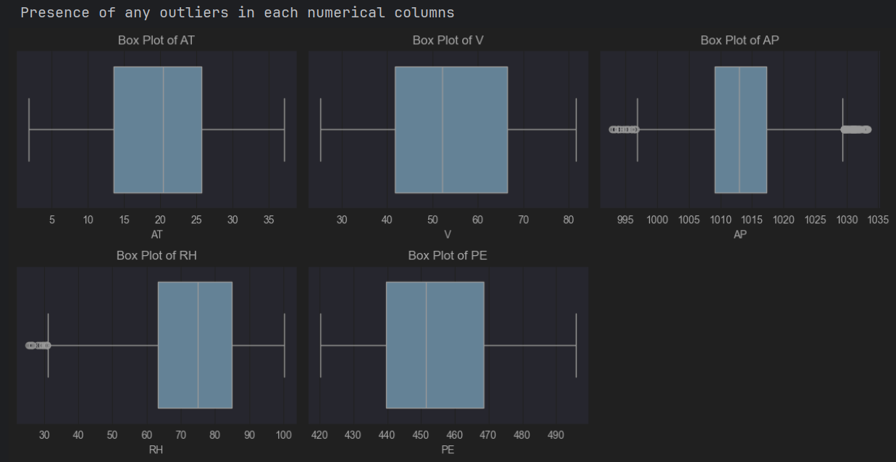
Detecting outliers/anomaly
As we can see, the outliers are mostly present in the columns like AP and RH, to improve feature scaling we need to remove the outliers

Slide 9
Removing Outliers by Using IQR from AP and RH columns
The Interquartile Range (IQR) is a measure of statistical dispersion, or in simpler terms, it shows the spread of the middle 50% of the data. The formula to calculate IQR is: **IQR = Q3-Q1** Where:
Q1 is the first quartile (25th percentile), which is the value below which 25% of the data fall.
Q3 is the third quartile (75th percentile), which is the value below which 75% of the data fall.
Steps to calculate IQR: - Order the data in ascending order. - Find Q1 (the median of the lower half of the data). - Find Q3 (the median of the upper half of the data). - Subtract Q1 from Q3 to get the IQR.
The IQR helps in identifying outliers. Typically, any data point that is below Q1 − 1.5 × IQR or above Q3 + 1.5 × IQR is considered an outlier.

Slide 10
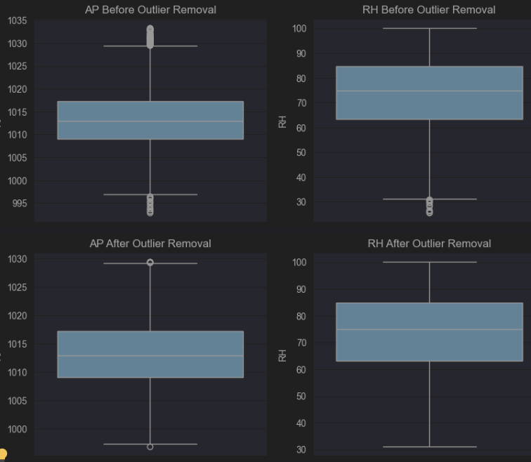
Visualizing before and after outliers from AP and RH COLUMNS
As we can conclude that we successfully removed the outliers (not all, but 98% are removed) !

Slide 11
Feature Extraction
It's crucial to evaluate a model's performance on unseen data to assess its generalization ability. This is where the train_test_split function from scikit-learn comes into play. **Training Set (X_train, y_train):** - Used to train the machine learning model. - The model learns patterns and relationships from this data. **Test Set (X_test, y_test):** - Used to evaluate the model's performance on unseen data. - It helps assess how well the model generalizes to new, unseen examples.

Slide 12
Feature Scaling: A Key Preprocessing Step (Optional in this situation)
***Common Feature Scaling Techniques:***
Min-Max Scaling (Normalization): Rescales features to a specific range, typically between 0 and 1.Formula: x_scaled = (x - min(x)) / (max(x) - min(x))
Standardization (Z-score normalization): Rescales features to have a mean of 0 and a standard deviation of 1. Formula: x_scaled = (x - mean(x)) / std(x)

Slide 13
Model Building
How XGBoost Works
Initial Prediction: Starts with a base prediction, such as the mean for regression.
Error Calculation: Calculates the residuals or errors from the current model.
Model Update: Fits a new weak learner (decision tree) to the residuals to correct errors.
Combination: Combines the previous model and the new weak learner using a learning rate to form the final prediction.

Slide 14
Initializing the XGBoost Regressor
objective='reg:squarederror = This parameter specifies the loss function to be minimized.reg:squarederror indicates that we're using squared error as the loss function, which is suitable for regression problems.
n_estimators = Number of boosting rounds
max_depth = Depth of each tree
learning_rate=0.1 = Shrinkage step

Slide 15
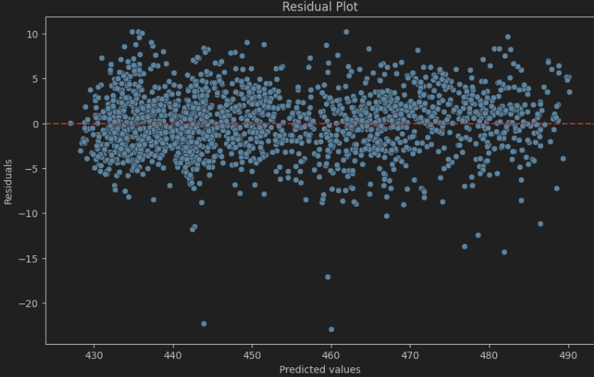
Model Evaluation Visualizations
Residual Plot: This is useful to visually inspect the difference between predicted and actual values. You should expect residuals (errors) to be spread evenly around zero. If they are biased in some way, it could indicate that the model isn't capturing some important patterns.

Slide 16
Insights from the Residual Plot:
Random Scattering Around Zero: The residuals appear randomly scattered around the zero line, indicating that the model captures the data pattern well and does not exhibit clear bias.
No Systematic Pattern: There is no discernible pattern (e.g., curved shape, clustering), which suggests that the model does not suffer from systematic errors like underfitting or overfitting.
Outliers: Some residuals deviate significantly from the zero line. These points could represent: Outliers in the data. Situations where the model struggled to predict accurately. If these points are minimal and random, they might not significantly impact the overall model.
Homoscedasticity: The residuals have a fairly constant spread (variance) across the range of predicted values, which suggests that the model meets the assumption of homoscedasticity.

Slide 17
Context of Data or Metrics
What were the values and dimensions used?
Independent Variables (Features/Dimensions) These are real-time environmental parameters that influence the energy output:
AT – Ambient Temperature (°C)
V – Exhaust Vacuum (cm Hg)
AP – Ambient Pressure (millibar)
RH – Relative Humidity (%)
Target Variable (Value/Metric) -> PE – Net hourly electrical energy output of the plant (in Megawatts)
Key Performance Metrics -> MAE (Mean Absolute Error) – Used to evaluate prediction accuracy and cross-Validated MAE Mean: ~2.23 (good model generalizability)

Slide 18
Executive Summary
Analyze and Built a tuned ML model to accurately predict energy output from real-world environmental data. To improve the ability of power plants to plan energy production, reduce inefficiencies, and adapt to environmental variability. The XGBoost model achieved a Mean Absolute Error of ~2.09, significantly outperforming traditional regression approaches and ensuring:
More reliable energy forecasting.
Reduced operational risks and improved resource allocation.
Clear environmental insights — such as how ambient temperature strongly influences energy output.

Slide 19
Technical Stack
Tools & Technologies A blend of analytical thinking and tech tools
Category | Tools Used
Programming Language | Python, SQL
Data Analysis | Pandas, NumPy
Visualization | Matplotlib, Seaborn, Tableau
Environment | Jupyter Notebook, PostgreSQL, Excel
Version Control | Git, GitHub

Slide 20
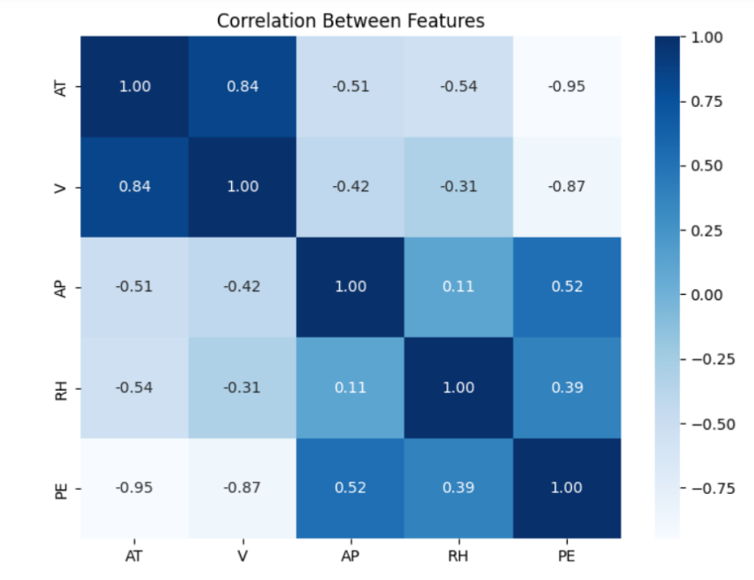
Insight Deep Dive
Environmental parameters
What we are looking: The relationship between output Energy across all the environmental parameters
Insights: Ambient Temperature (AT) usually has a strong negative correlation with Power Output.

Slide 21
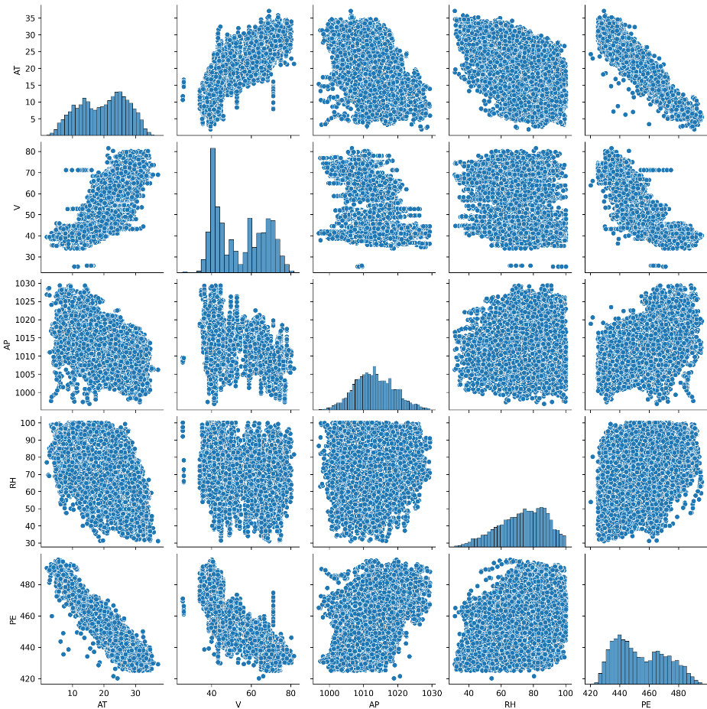
Pairplots for all Environmental parameters
What are we looking: Exploratory data analysis (EDA) and visualizing relationships within a dataset, Understanding Pairwise Relationships, Identifying Correlations and Patterns and Comparing Groups within Data.
Insights: Relationships Between Variables: There seems to be negative correlation between AT (Ambient Temperature) and PE (Power Output), which makes sense as higher temperatures might reduce efficiency in energy production. V (Exhaust Vacuum) shows a relatively strong positive correlation with PE. AP (Ambient Pressure) and RH (Relative Humidity) appear to have weaker relationships with PE.

Slide 22
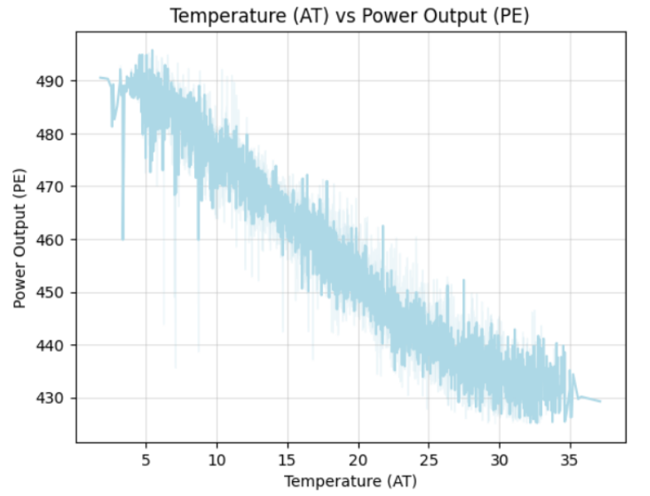
Temperature and Power Output Trend
What we are looking: As temperature increases, power output tends to decrease — likely due to thermodynamic efficiency loss.
Insights: Higher temperatures (AT) negatively affect the power output (PE). This is due to reduced efficiency in thermal energy conversion as the ambient temperature increases.

Slide 23
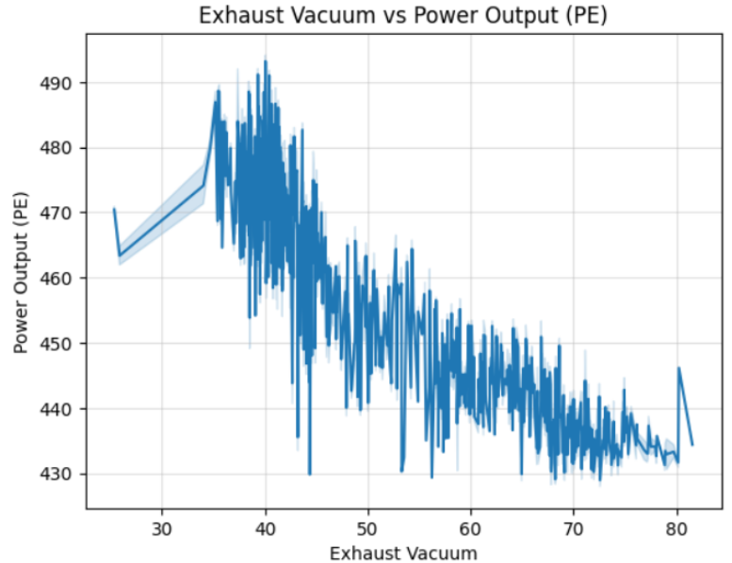
Exhaust Vacuum and Power Output Trend
What we are looking: The relationship between vacuum level (condenser pressure) and turbine power output/efficiency is negatively correlated—but in a way that improves performance as vacuum increases.
Insight: Vacuum (V) has a strong negative correlation with PE. As vacuum increases, the turbines operate more efficiently, leading to higher power output. While vacuum and condenser pressure are inversely related, power output increases with higher vacuum (up to an optimal point). So, the useful effect is positive, but the physical correlation is negative.

Slide 24
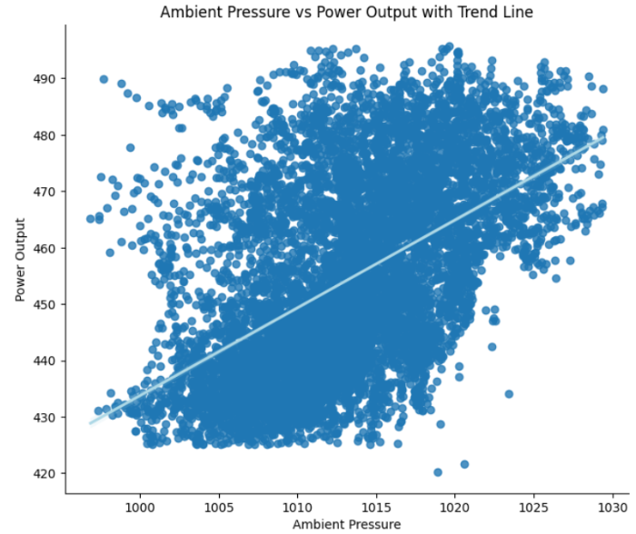
Ambient Pressure vs. Power Output
What we are looking: Positive correlation as Higher ambient pressure improves both gas and steam turbine performance in a CCPP.
Insights: Ambient pressure (AP) shows a moderate positive correlation with PE. Higher pressures improve combustion efficiency in power plants, resulting in better energy conversion.

Slide 25
Summary
Temperature (AT) has the strongest negative correlation with power output. Higher temperatures reduce energy efficiency.
Exhaust Vacuum (V) also shows a strong inverse relation with PE.
Pressure (AP) and Humidity (RH) have moderate effects but contribute to overall accuracy when retained.
Business Recommendations
A/B Testing or Pilot Rollout Suggestion
A/B Test: Compare performance between plants using model-based scheduling vs. traditional.
A: Plant using AI-based energy forecasting
B: Control plant using existing heuristics

Slide 26
Business Impact
How did this analysis help them? This data-driven analysis delivers the following strategic advantages:
Operational Optimization: By accurately predicting energy output, operators can make informed decisions on fuel usage and turbine operations to improve overall plant efficiency.
Cost Reduction: Reducing overproduction or underproduction minimizes wastage of resources and cuts down operational costs.
Capacity Planning: Helps forecast peak and low generation hours, supporting better load balancing and infrastructure usage.
Environmental Benefits: Efficient power generation leads to lower emissions per unit of energy, aligning with sustainability goals.
Decision Support: Provides a foundation for scenario planning (e.g., "What if temperature rises by 5°C?") using predictive analytics.

Slide 27
From Model to Action
Short-Term Actions
1. Deploy the Model Internally for Forecasting
Use the XGBoost model to predict energy output (PE) a day in advance.
Allow operations team to adjust turbine settings proactively.
2. Create Alert System for Inefficient Conditions
Based on AT (Ambient Temperature) and V (Exhaust Vacuum) thresholds, alert when predicted output drops below baseline.
Helps minimize unexpected energy loss.
3. Build a Real-Time Dashboard (Optional with Tableau)
Show predicted PE vs. actual PE
Useful for on-ground operators and energy planners.
Long-Term Actions
1. Integrate Prediction with Power Demand Scheduling
Align energy output forecasting with expected demand curve (load balancing).
Helps reduce fuel cost, optimize resource usage.
2. Feedback Loop for Model Retraining
Collect actual vs. predicted values weekly.
Automate model retraining to improve over time.
3. Extend Model to Include Cost & Emissions Metrics
Add fuel consumption, emission data, and maintenance logs.
Enable multi-objective optimization: energy + cost + sustainability.

Slide 28
Department-Wise Alignment
Department | How This Project Helps
Operations | Improve efficiency by adjusting to environmental changes ahead of time
Product (Energy Scheduling Tools) | Embed the model into digital control systems or energy apps
Marketing & CSR | Showcase use of AI/ML in optimizing energy and reducing emissions
Finance | Forecast more accurate budgets based on predicted output

Slide 29
Stakeholders
Who needs this and for what purpose?
Plant Operations Manager – To optimize real-time energy production and resource allocation.
Energy Analysts / Data Analysts – To monitor trends and predict performance based on weather data.
Finance/Cost Management Team – To assess cost implications of different production scenarios.
Maintenance and Engineering Teams – To align maintenance schedules with low output periods.
Executives & Strategic Planners – To make high-level decisions on expansion, contracts, and investments.

Slide 30
Model Performance Summary
Metric | Score
Train MAE | 0.94
Test MAE | 2.09
Cross-Val MAE (Mean ± Std) | 2.23 ± 0.035
Improved model reliability by identifying key input features and achieving a Mean Absolute Error (MAE) of ~2.09 using robust evaluation metrics.
Supported plant operations by enabling smarter decisions on fuel usage, equipment maintenance, and energy demand planning based on predictive insights.

Slide 31
References
Prediction of full load electrical power output of a base load operated combined cycle power plant using machine learning methods
https://contactsunny.medium.com/label-encoder-vs-one-hot-encoder-in-machine-learning-3fc273365621
https://www.javatpoint.com/feature-selection-techniques-in-machine-learning
https://www.mathworks.com/discovery/machine-learning-models.html

Slide 32
Thank You

